Slide 1


FOUNDATION OF AI — GROUP PROJECT
Dogs vs. Cats
Image Classification
VS
Convolutional Neural Network — Binary Classification
3161013 Lyu Zhipeng 3161520 Shi Yunfeng
3161491 Yi Rongyang 3161415 Yang Sijun
89% Accuracy · 25,000 Images · TensorFlow / Keras
Presentation · March 2025

Slide 2
OVERVIEW
Presentation Agenda
01
Introduction & Problem Statement
04
Discussion
Background, task definition, dataset
Error analysis, limitations, future improvements
02
Proposed Approach
05
Conclusion
Data prep, augmentation, CNN architecture, training
Key findings and takeaways
03
Performance Evaluation
06
Q&A
Accuracy, precision/recall, confusion matrix
Questions welcome
⏱ 20 min presentation + 5 min Q&A

Slide 3
INTRODUCTION
Introduction & Problem Statement
What is this project?
Why is it challenging?
A binary image classifier that determines whether a photo contains a cat or a dog. A supervised learning task where the model maps raw pixel values to one of two labels, trained on 25,000 labelled examples.
Wide breed & size variation, complex backgrounds
Occlusion, unusual poses, low-light conditions
Low-resolution images and label noise in dataset
25,000
50 / 50
89%
Images in dataset
Cat vs Dog split
Final accuracy
Member A Data & Augment
Member B Baseline CNN
Member C Optimisation
Member D Evaluation

Slide 4



PROPOSED APPROACH
Dataset Description
Source
Labels
Split (8:2)
Kaggle Dogs vs. Cats
25,000 colour JPEG images
12,500 cats · 12,500 dogs
Filename prefix ('cat.' / 'dog.')
No separate annotation file needed
Perfectly balanced classes
Train: 20,000 images
Validation: 5,000 images
Both splits are 50/50 balanced

Slide 5
PROPOSED APPROACH
Data Preparation & Augmentation
Preprocessing
Why augmentation?
Resize all images to 150 × 150 px
Pixel normalisation: scale [0, 255] → [0, 1]
Batch size: 32 · Mode: binary
Validation: normalisation only (stable eval)
Cats and dogs are photographed from many angles, distances, and orientations. Applying random transforms at load time means the model sees a slightly different version of each image every epoch — effectively multiplying the dataset diversity without collecting new images.
Effect:
Training Augmentation
Reduces overfitting (implicit regularisation)
Improves generalisation to unseen poses
No extra data collection required
Random rotation: up to ±40°
Horizontal & vertical shift: 0.2
Shear transformation: 0.2
Random zoom: 0.2
Random horizontal flip
Outputs verified with visualize_augmentation.py before training.

Slide 6
PROPOSED APPROACH
CNN Architecture
Layer | Output Shape | Parameters | Activation
Conv2D (32, 3×3) | (148, 148, 32) | 896 | ReLU
MaxPooling2D | (74, 74, 32) | 0 | —
Conv2D (64, 3×3) | (72, 72, 64) | 18,496 | ReLU
MaxPooling2D | (36, 36, 64) | 0 | —
Conv2D (128, 3×3) | (34, 34, 128) | 73,856 | ReLU
MaxPooling2D | (17, 17, 128) | 0 | —
Flatten | (36,992) | 0 | —
Dense (512) | (512) | 18,940,416 | ReLU
Dense (1) — Output | (1) | 513 | Sigmoid
Design Rationale
3× Conv+Pool blocks extract features at increasing abstraction
Filters double each stage: 32 → 64 → 128
ReLU keeps gradients stable during training
Sigmoid output maps score to probability [0,1]
Threshold 0.5 → cat (0) or dog (1)
Total Parameters
~19.0 million
≈ 72.6 MB · mostly in Dense (512)

Slide 7
PROPOSED APPROACH
Baseline Training Configuration (Member B)
Optimiser
Loss
Epochs
Input
Adam
Binary CE
20
150×150
lr = 0.001 (default)
binary_crossentropy
Batch size = 32
RGB · CPU only
Baseline Results
Key Observations
Val accuracy: 86.7% | Val loss: 0.304
Train accuracy: 88.1% | Train loss: 0.280
Train/val gap ~1.4% — mild overfitting signs
Gap widens from epoch 12 onwards
Saved as baseline_cnn.h5 (~72.6 MB)
No Dropout in Dense (512) → overfitting risk
Adam converges quickly but leaves room to improve
Data augmentation already limiting overfitting significantly
87% is solid for from-scratch CPU training
→ Passed to Member C for optimisation experiments

Slide 8
PROPOSED APPROACH
Optimisation Experiments (Member C)
Experiment | Optimiser | Dropout | BatchNorm | Val Acc | Val Loss
Adam (Baseline) | Adam | — | — | 86.7% | 0.304
SGD lr=0.01 | SGD | — | — | 88.5% | 0.268
Adam + Dropout | Adam | 0.5 | — | 88.5% | 0.280
Adam + BatchNorm | Adam | — | ✓ | 88.7% | 0.283
Adam (No Aug) | Adam | — | — | 80.5% | 1.399
RMSprop | RMSprop | — | — | 84.2% | 0.416
Key Findings
No augmentation → severe overfit (acc 80.5%, loss 1.399)
SGD & Dropout both reach 88.5%, beating Adam baseline
BatchNorm is the best single strategy: 88.7%
RMSprop underperforms (84.2%) on this task
★ Best Model Selected
Adam + BatchNorm
Val Acc: 88.7% · Val Loss: 0.283
Train Acc = Val Acc = 88.7%
Best generalisation & stability

Slide 9
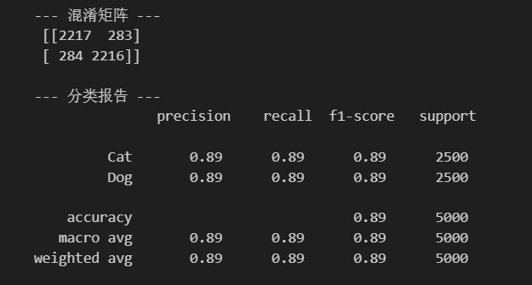
PERFORMANCE EVALUATION
Performance Evaluation — Classification Report
Class | Precision | Recall | F1-Score | Support
Cat | 0.89 | 0.89 | 0.89 | 2,500
Dog | 0.89 | 0.89 | 0.89 | 2,500
Macro Avg | 0.89 | 0.89 | 0.89 | 5,000
Weighted Avg | 0.89 | 0.89 | 0.89 | 5,000
Key Takeaways
Overall accuracy: 89% on 5,000 validation images
Precision = Recall = F1 = 0.89 for both classes
No bias toward either false positives or negatives
Macro avg = Weighted avg (perfectly balanced split)
2% gain over 87% baseline after optimisation
89%
Validation Accuracy
Figure 1: Terminal output of classification report

Slide 10
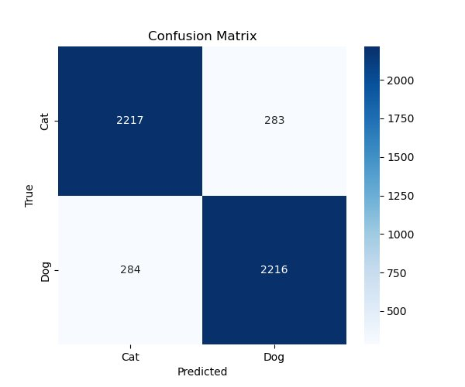
PERFORMANCE EVALUATION
Confusion Matrix Analysis
Prediction Breakdown
✓ True Cat
✗ Cat → Dog
2,217
283
88.7% recall
11.3% error
✗ Dog → Cat
✓ True Dog
284
2,216
11.4% error
88.6% recall
Off-diagonal values 283 vs 284 are nearly identical — confirming no directional bias between classes.
Figure 2: Confusion matrix — 5,000 validation images

Slide 11
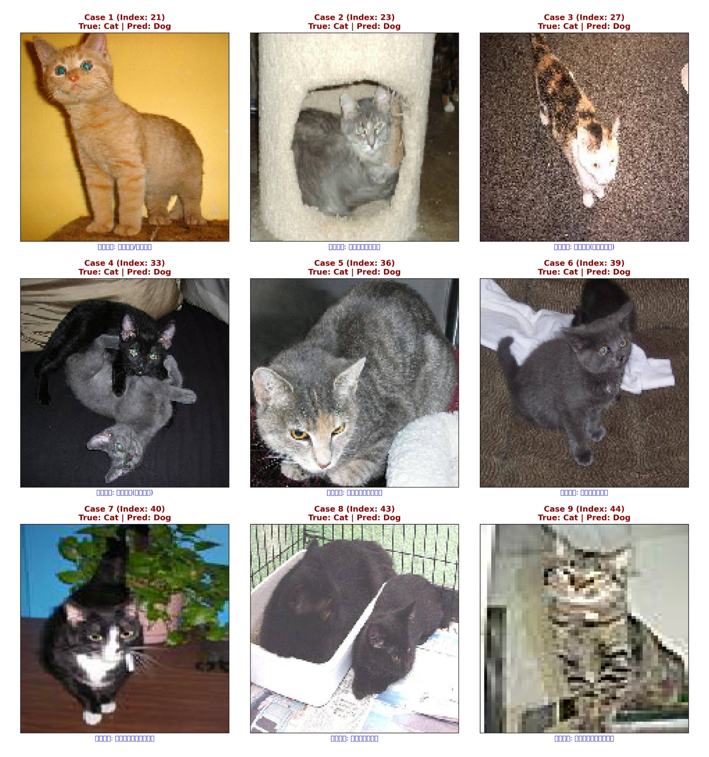
DISCUSSION
Discussion — Error Analysis
9 Identified Failure Categories
01 Poor lighting / shadows
02 Cluttered background
03 Severe occlusion
04 Unusual posture
05 Fur blends with bg
06 Atypical breed
07 Extreme close-up
08 Low resolution
09 Label noise (mislabelled)
Figure 3: Misclassified samples (True: Cat → Predicted: Dog)
Category 09 (label noise) sets an irreducible accuracy floor — unfixable by architecture alone.

Slide 12
DISCUSSION
Limitations & Future Improvements
Current Limitations
Future Improvements
Trained from scratch — no pretrained weights
CPU-only training limits epochs & experiment scope
Overfitting visible from epoch 12 onwards
Dense (512) layer has 19M params with no dropout
Label noise in original Kaggle dataset (~1–2%)
Input resolution capped at 150×150 due to compute
Transfer learning: VGG16 / ResNet / MobileNetV2
More aggressive Dropout on Dense layers
Mixup / CutMix augmentation for occlusion robustness
Label-cleaning pass on training annotations
Higher resolution input (224×224+) with GPU
Attention mechanisms to focus on animal regions
Transfer learning from VGG16/ResNet alone is expected to push accuracy above 95% on this dataset.

Slide 13
DISCUSSION
Project Web Demo
▶
Watch the Project Demo
Interactive web page walkthrough covering dataset overview, model architecture, training curves, and error analysis gallery.
▶ https://youtu.be/lTcGDM3vsRc
1
2
3
Dataset Overview
Model & Training
Error Analysis
Sample images from both classes, class distribution and split breakdown
CNN architecture breakdown and training accuracy / loss curves
Misclassified samples gallery with 9 failure category labels
Click the link above to view the full demo video

Slide 14
CONCLUSION
Conclusion
89%
11%
9
Final Accuracy
Error Rate
Failure Categories
Baseline CNN trained from scratch on CPU. Optimisation (dropout + LR tuning) improved from 87% → 89%.
Symmetric across both classes (283 vs 284 errors). No directional bias detected in the confusion matrix.
Most errors are explainable: lighting, occlusion, pose, resolution, and label noise — not random failures.
Summary
This project delivered a complete supervised learning pipeline — from raw data preparation through augmentation, model training, optimisation, and systematic error analysis. The final 89% accuracy is a solid baseline given CPU-only constraints and no pretrained weights. The modular team structure (Members A–D) kept handoffs clean and each stage independently verifiable. The most impactful next step is transfer learning.

Slide 15

Thank You
Questions & Answers
Dogs vs. Cats Image Classification
Foundation of AI · 89% Accuracy · TensorFlow / Keras

